Slide 1



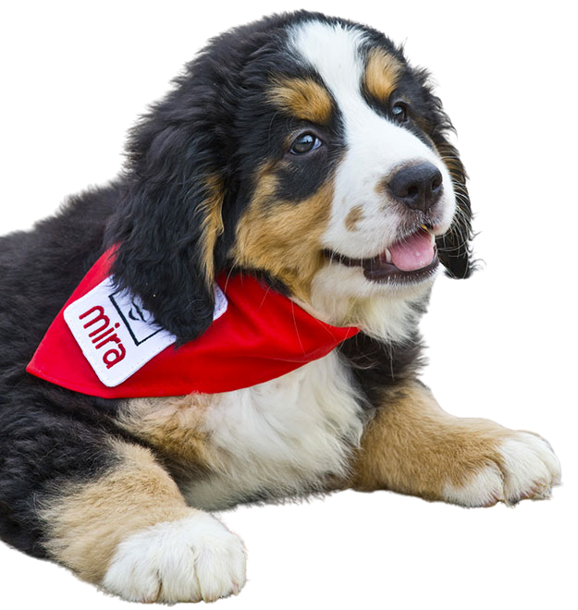




MIRA FOUNDATION USA, INC.
Bonnie Archibald
Associate Director
Mira Foundation USA
510 NW Broad Street
Southern Pines, NC 28387
910-691-0438
info@mirausa.org
www.mirausa.org

Slide 2


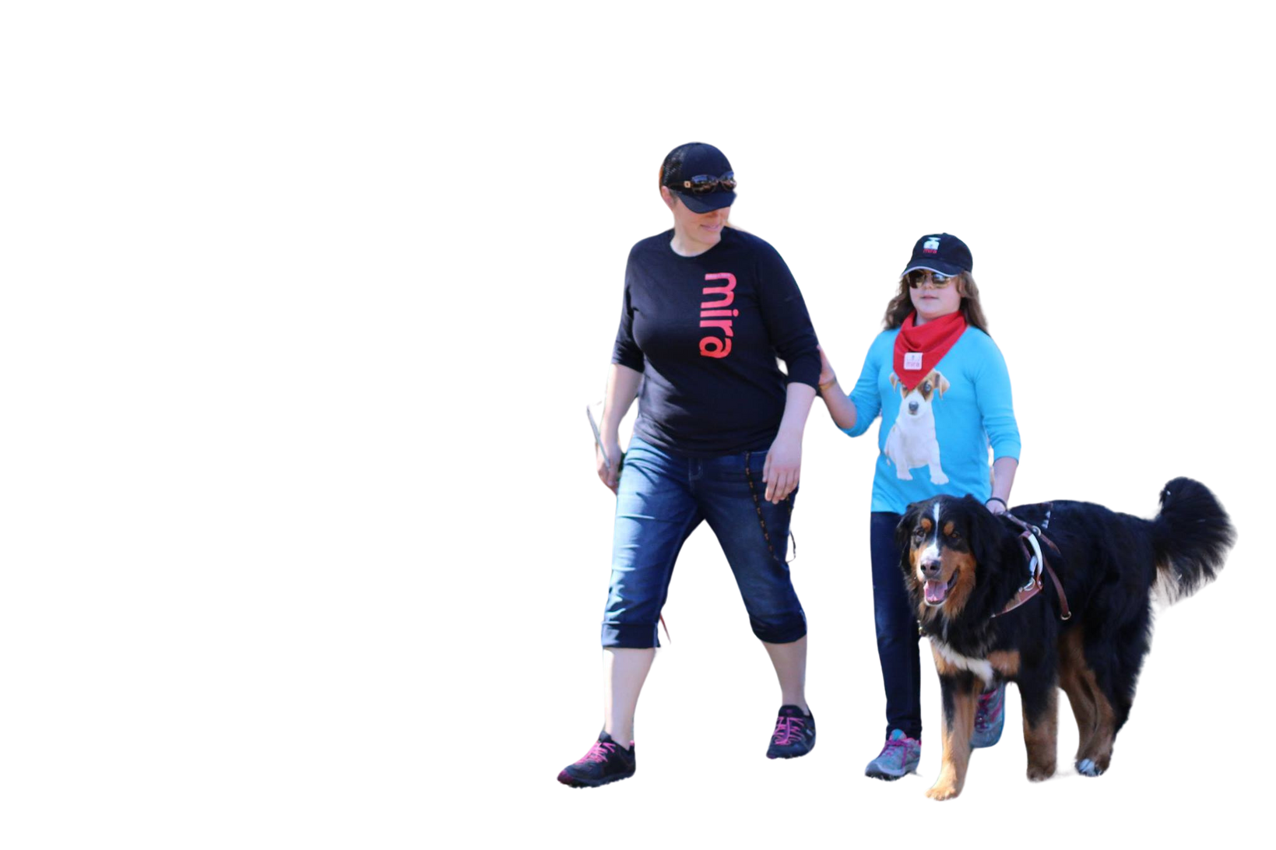


ABOUT US
MISSION STATEMENT
To provide guide dogs to blind children and young adults to foster independence and mobility.

Slide 3


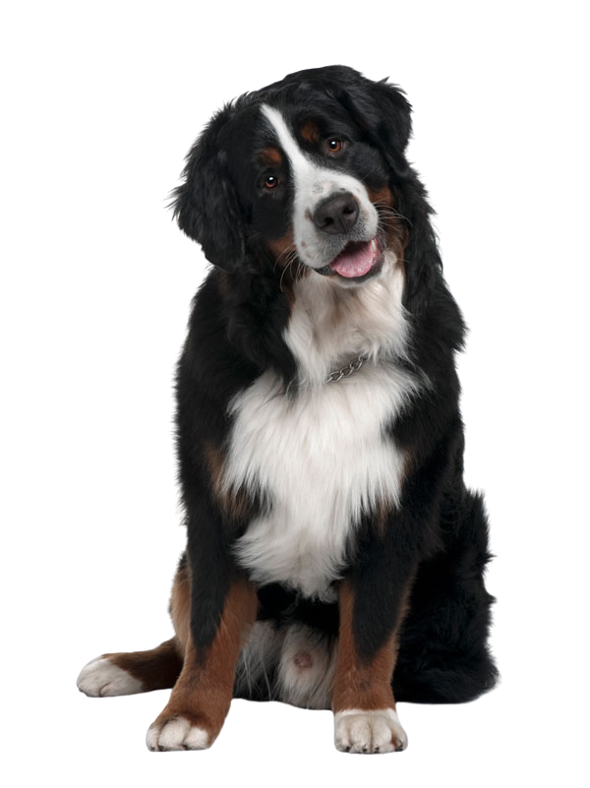
WHY US
WE ARE THE FIRST ORGANIZATION TO GIVE GUIDE DOGS TO CHILDREN BETWEEN THE AGES OF 11 AND 17
Mira USA starts accepting application when a child turns 9 but pairing begins at age 11 all the way through age 17.
OTHER SCHOOLS
The Seeing Eye - Starts at age 16
Guide Dogs of America - Starts at age 18
Guiding Eyes for the Blind - Starts at age 16
Dogs, Inc - Starts at age 15
Freedom Guide Dogs - Starts at age 15
Guide Dogs for the Blind - Starts at age 18

Slide 4

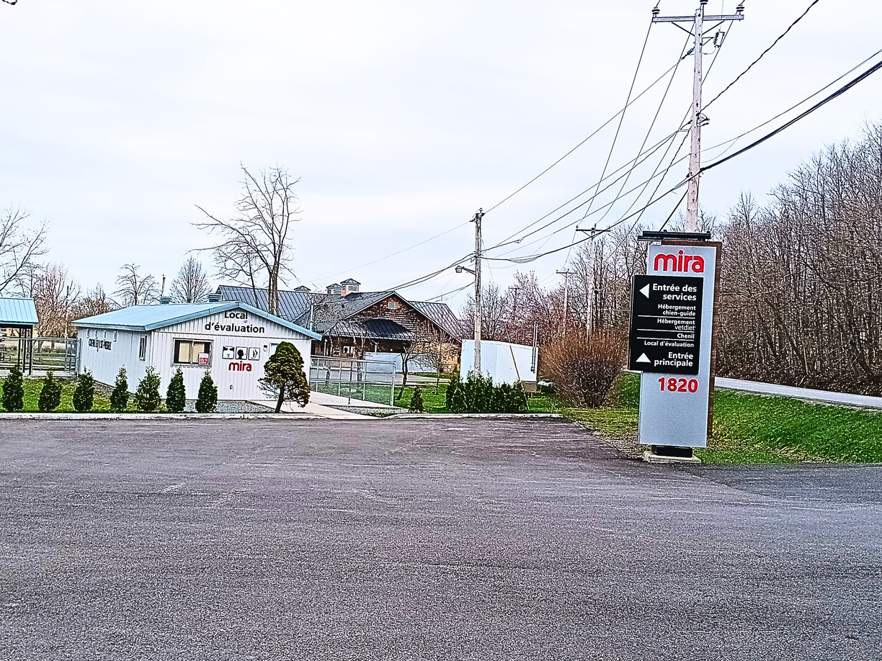
FOUNDATION MIRA - CANADA
Located in Quebec, Canada.
Have been placing guide dogs with children for over 30 years.
Where they breed and train the guide dogs.
Where the Mira USA guide dog school is located.

Slide 5
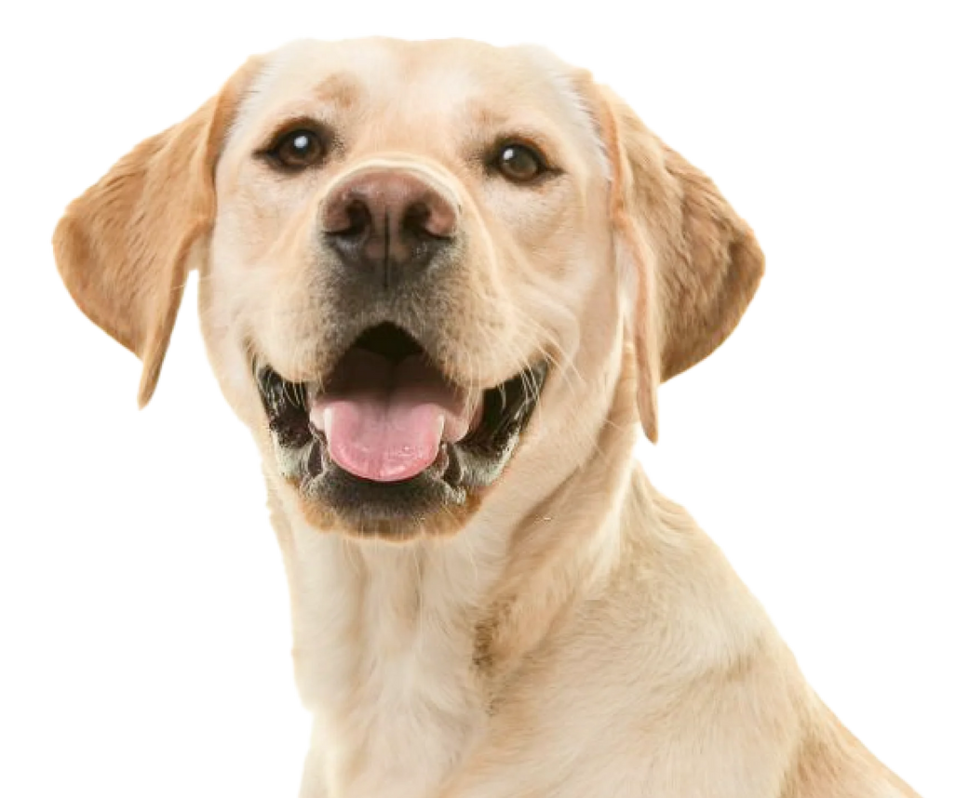

Labrador
MIRA DOGS
HARD-WORKING DOG WITH A HEART OF GOLD
VERY RECEPTIVE TO THEIR ENVIRONMENT
GREAT SELF-CONFIDENCE
EASY TO LIVE WITH
THEY FORGIVE EASILY, MAKING FOR A FRIENDLY DOG
ALWAYS READY TO ASSIST AND GUIDE THEIR MASTER

Slide 6
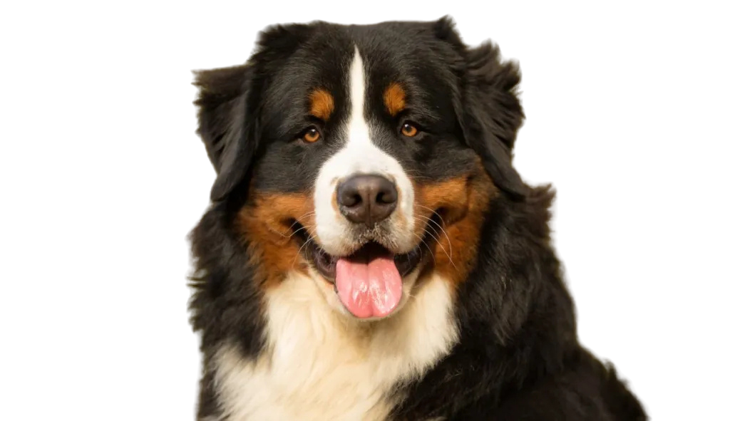
Bernese Mountain Dog
MIRA DOGS
CONTINUALLY SEEK HUMAN CONTACT
UNPARALLELED INTELLIGENCE
NATURALLY VIGILANT
FAITHFUL COMPANIONS
GREAT ABILITY TO UNDERSTAND AND ANALYZE PROBLEMS ARISING FROM COMPLEX SITUATIONS
INSTINCTIVELY PROTECTIVE

Slide 7

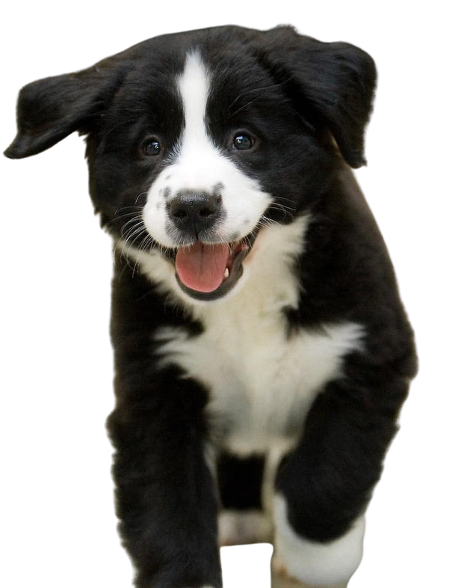
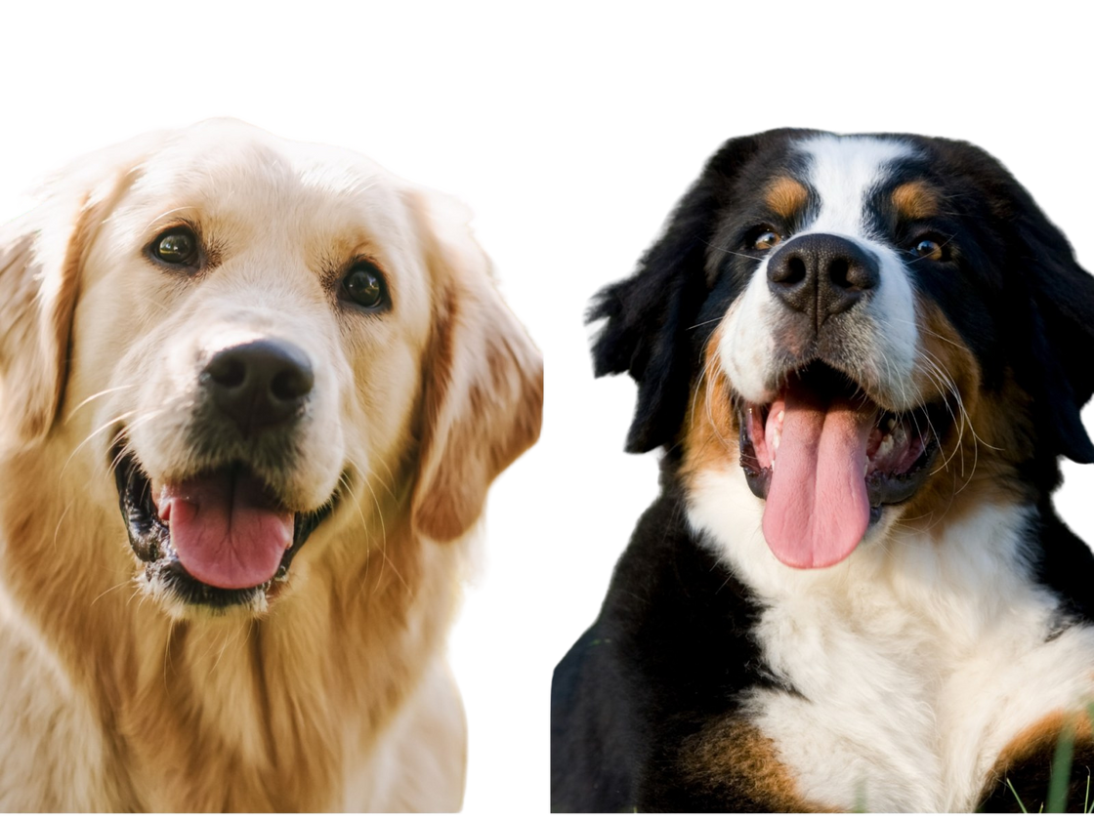
LABERNESE
MIRA DOGS

Slide 8
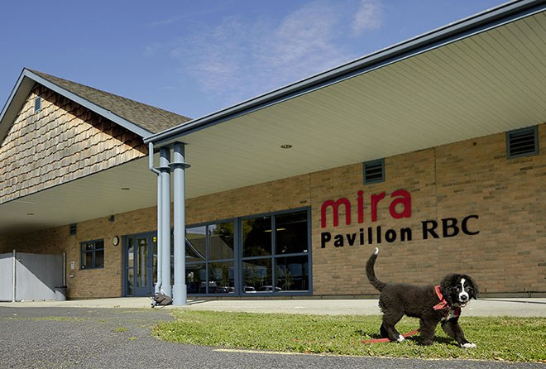
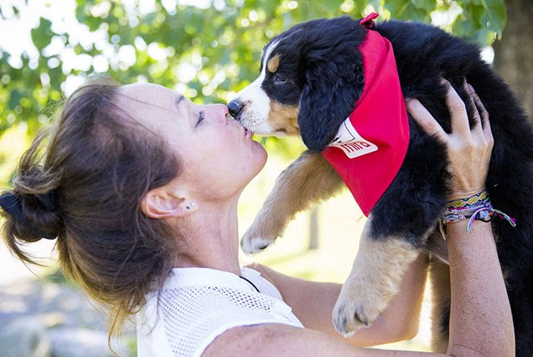
MIRA DOGS
Born & stay by their mother’s side for 9 weeks
Placed with foster families for 12-18 months

Slide 9
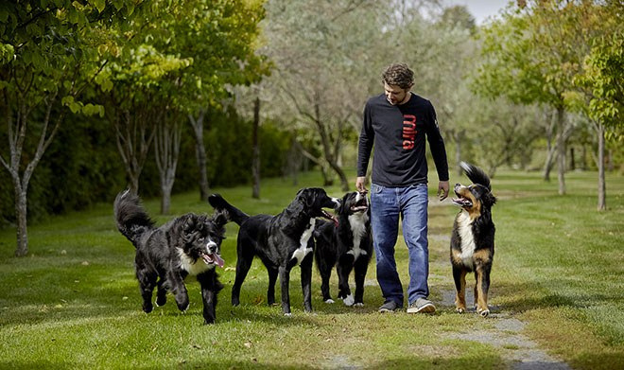
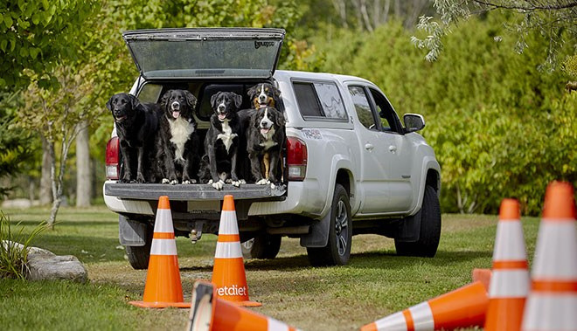
Mira Dog Birth – 1 year
MIRA DOGS
At 1 year old - Return to Mira and are evaluated to determine program assignment
3-8 months of training
depending on program selection

Slide 10
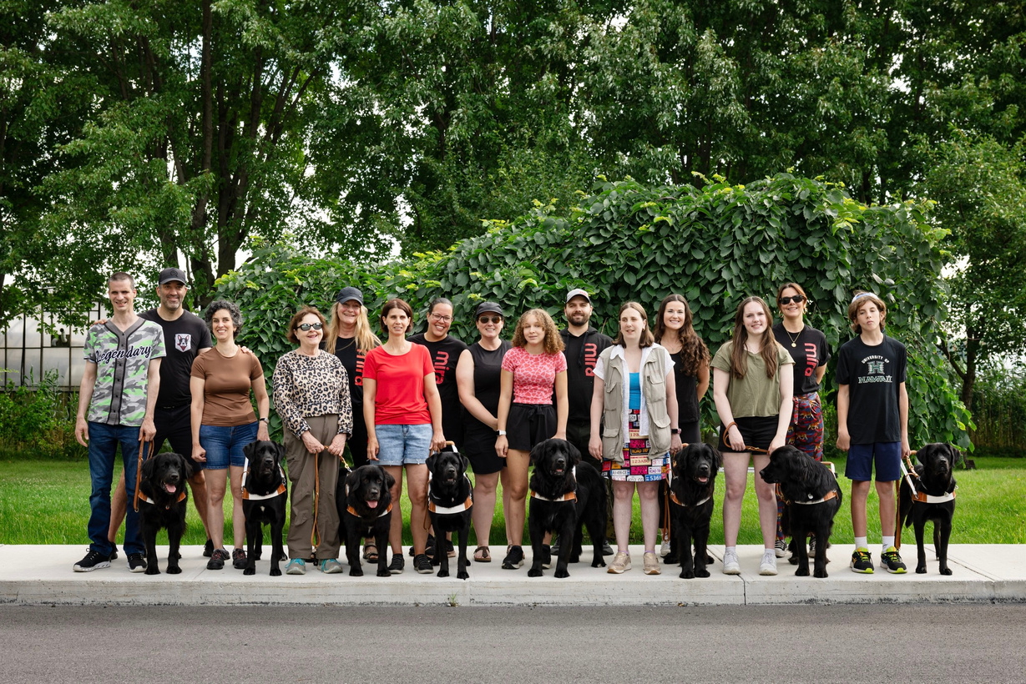

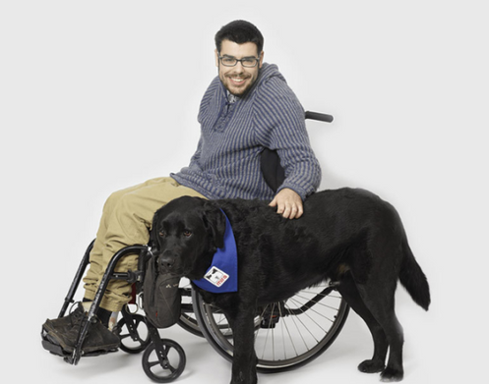
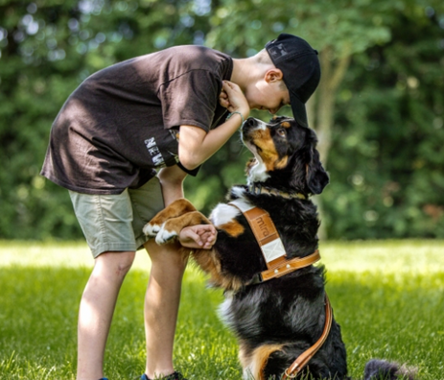
3 PROGRAMS
Child’s Guide Dog
Adult’s Guide Dog
Mobility Assistance Dog
Autism Assistance Dog

Slide 11

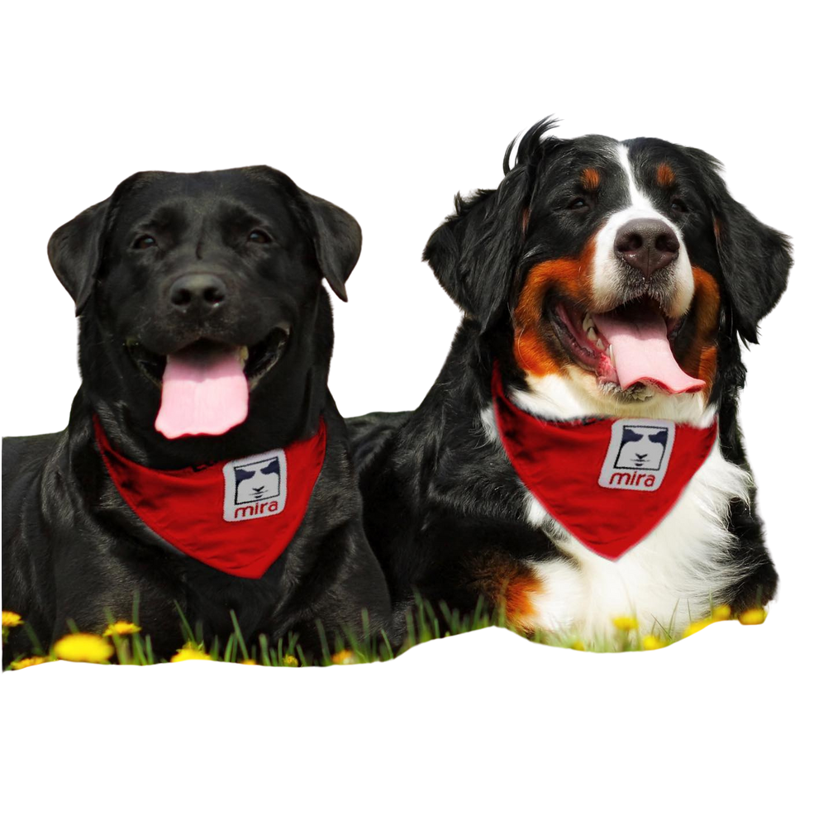
DID YOU KNOW?
All of Mira’s dogs learn french commands
All of Mira’s dogs are name from themes
Mira came from a dog named Mirabelle - Also spanish “to see”
Some people use a stage name for their dog

Slide 12
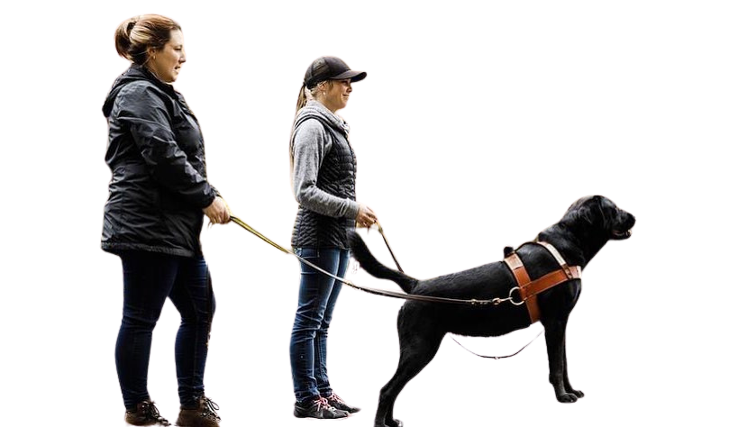
CANDIDATE GUIDELINES
Between the age of 11 and 17
Have or can get a passport
20/600 visual acuity or below
Lacking a furry friend
Good O&M skills and the ability to perform tasks independently
US citizens ready for a guide dog

Slide 13
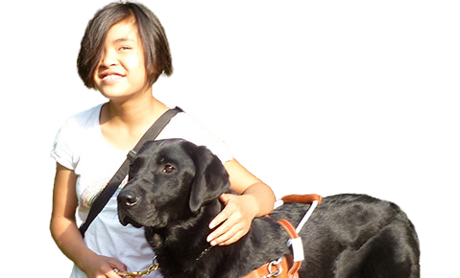


The Process – Initial Application
THE PROCESS
REQUIRED INFORMATION
APPLICATION
Quick 5 minute initial application.
If approved, candidate will start the formal application process.
Medical Report
Ophthalmologist or Optometrist Report
O&M Report & Assesment of Skills
Videos of Applicants Orientation & Mobility Skills
IEP Report from School

Slide 14
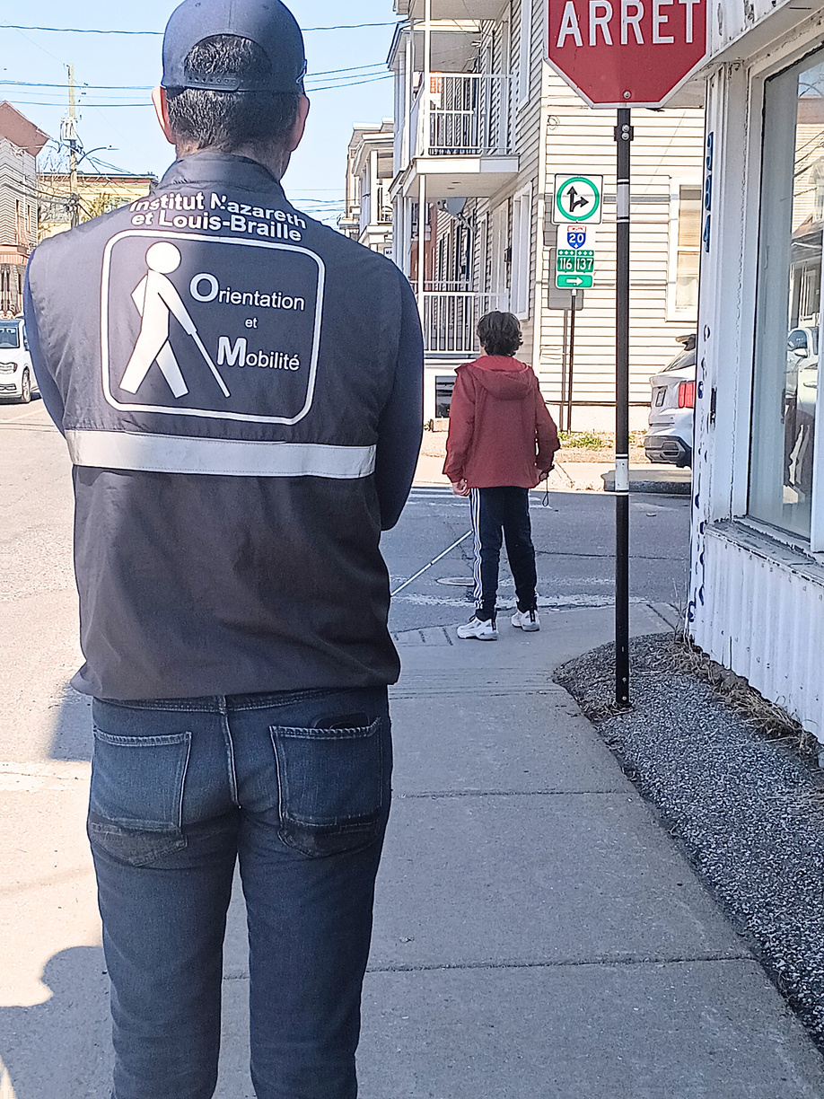
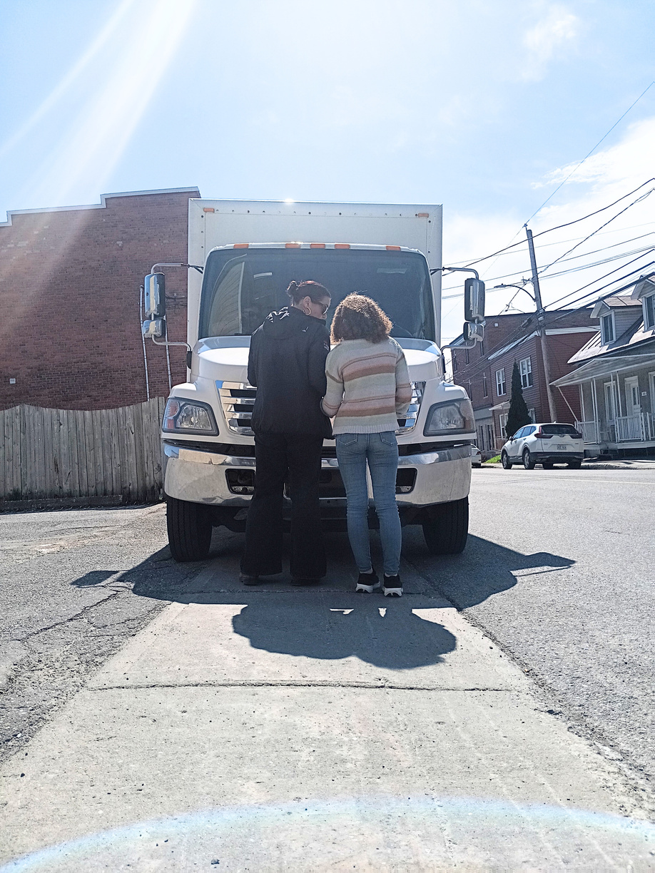
The Process – Evaluation Weekend
THE PROCESS
EVALUATION
Students' orientation and mobility skills are evaluated, along with their ability to walk with a Mira guide dog during the evaluation weekend.
Parents and the student’s O&M Instructor participate in training, meet other families, and ask questions.
Not all students will receive a guide dog; some may need to work on skills for future eligibility.

Slide 15
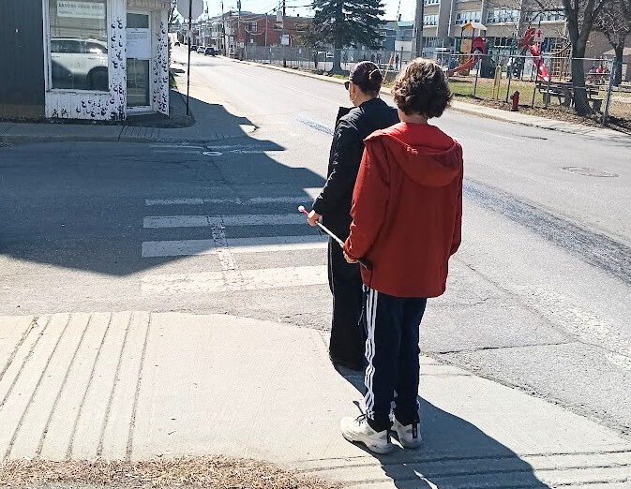
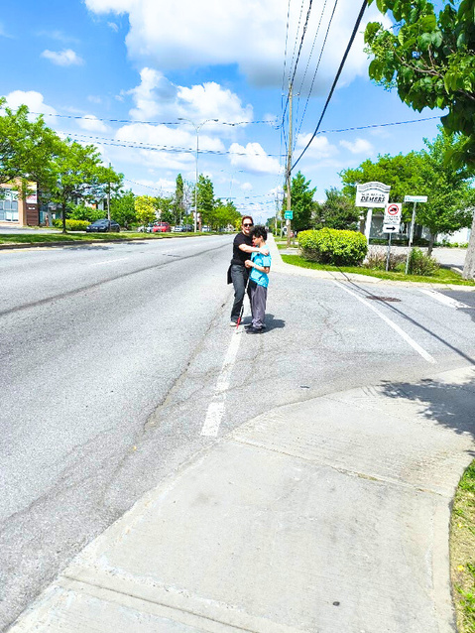
The Process – O&M Evaluation Explained
O&M EVALUATION
GUIDE DOG TRAVEL
Move away from tactile input and focus on auditory input
Look at kinesthetic, traffic pattern and intersection analysis, using parallel traffic to maintain a straight line when travelling, etc
We require the implementation of the skills found in the video that was made in association with the Institut Nazareth et Louis-Braille in Montreal
Assessment of prerequisite skills
O&M for transitioning to guide dog travel developed by the Nazareth and Louis Braille Institute

Slide 16
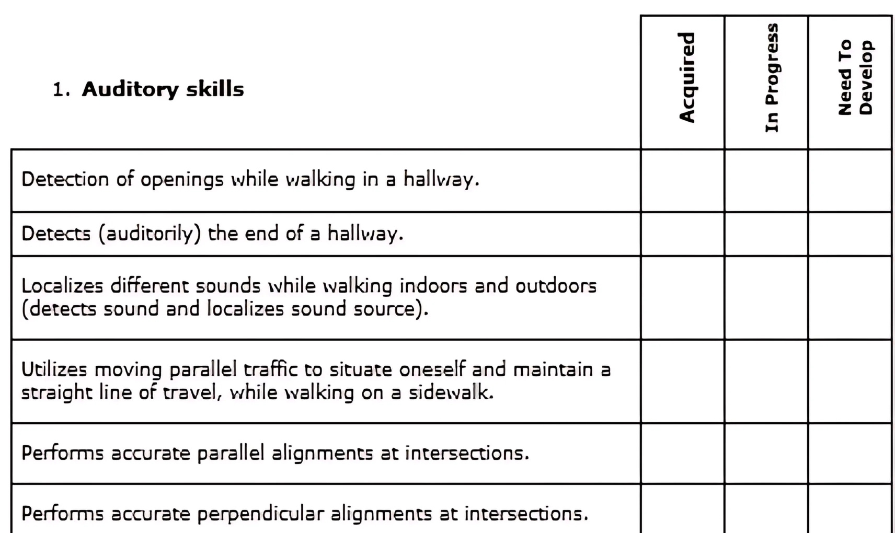
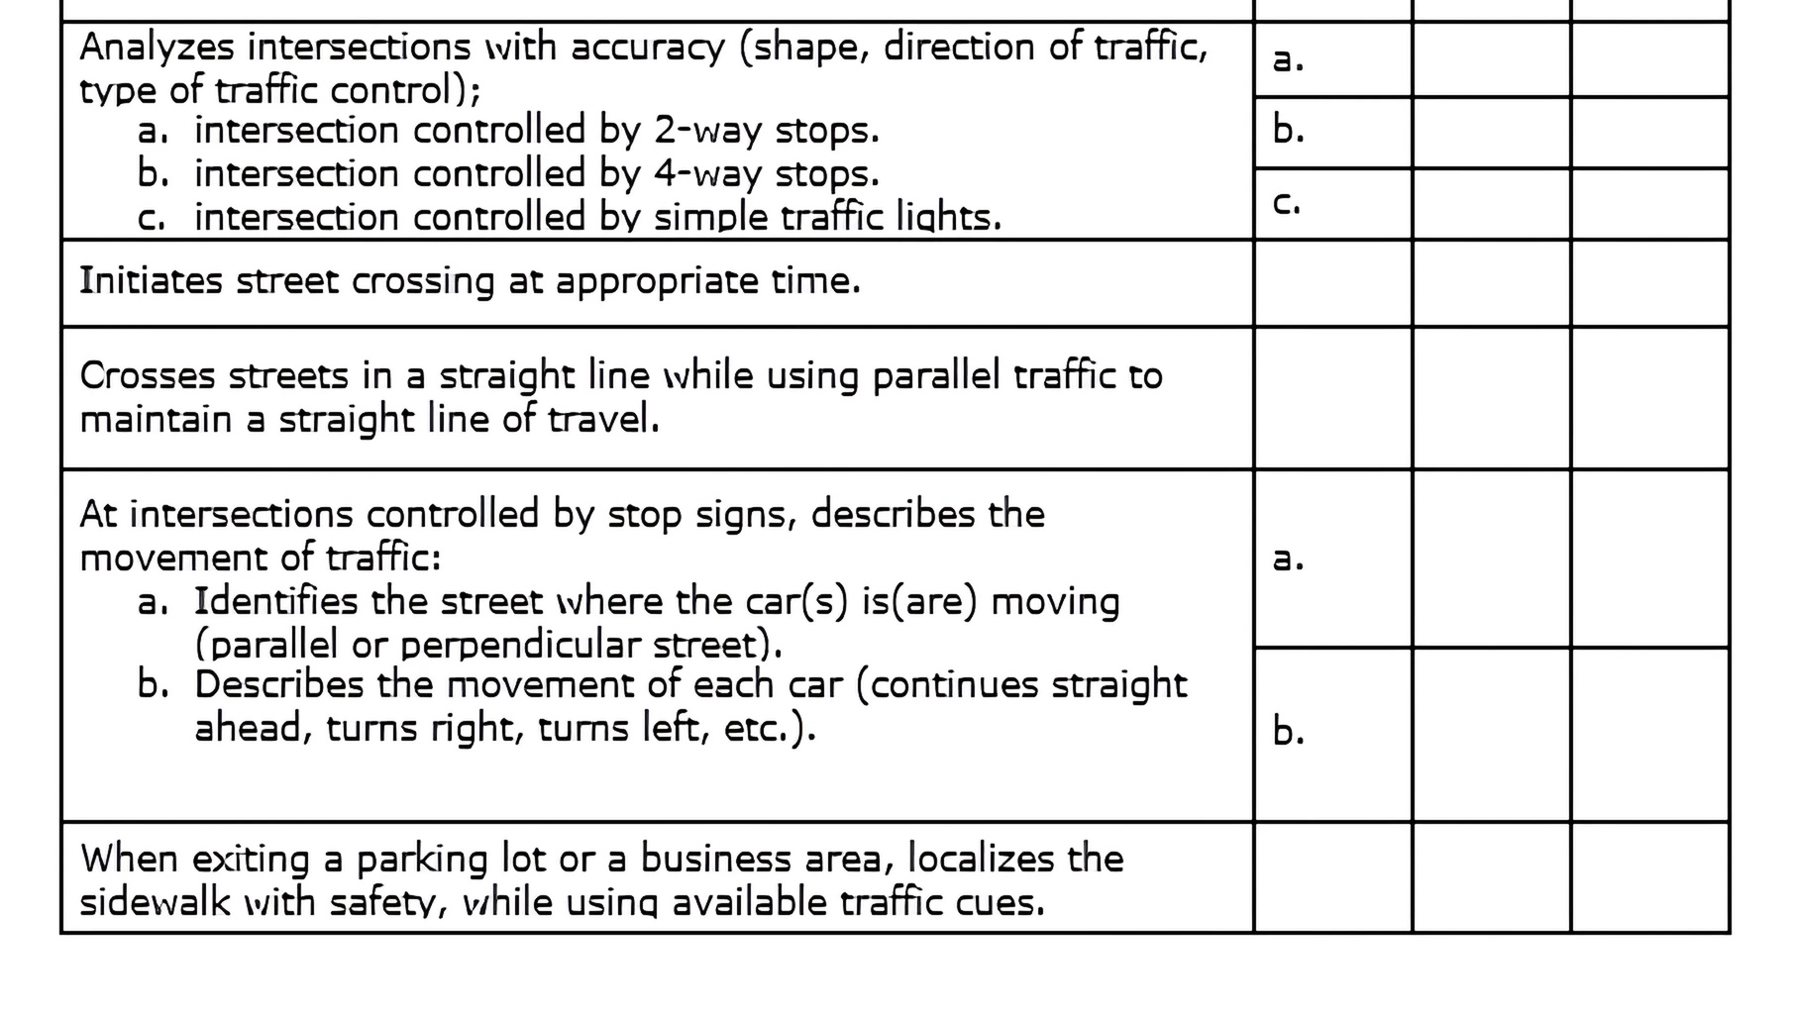
AUDITORY
SKILLS

Slide 17
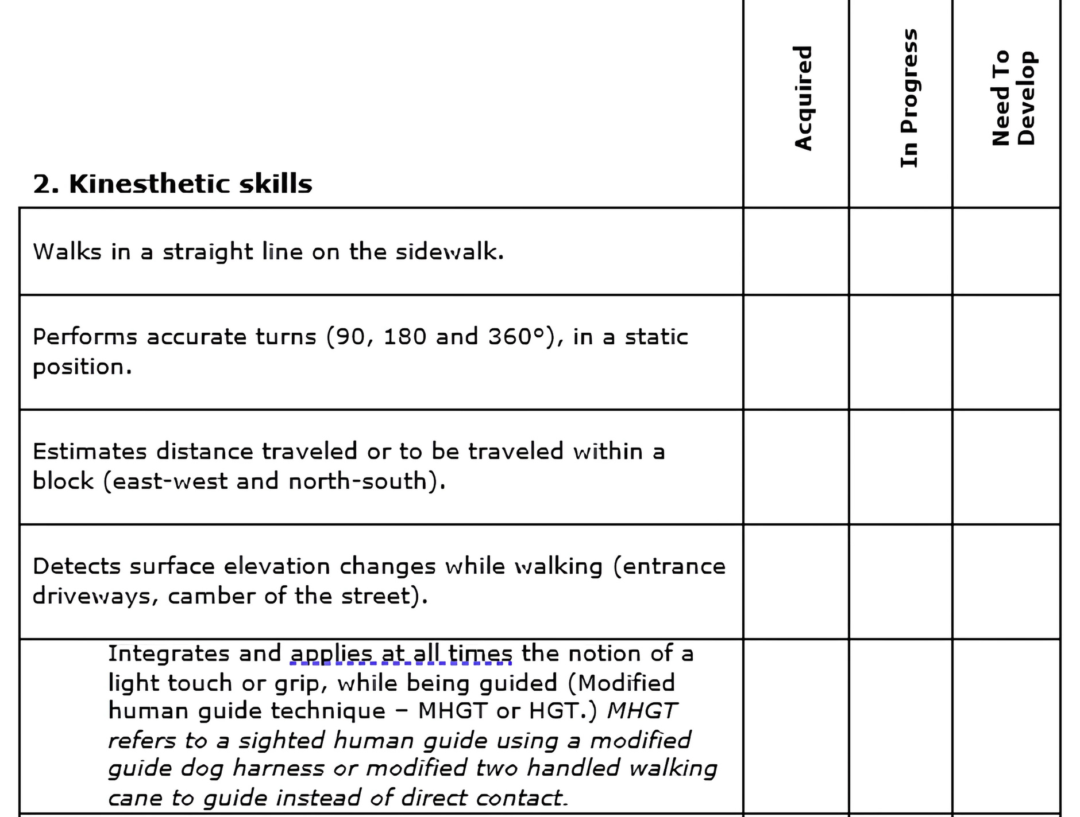
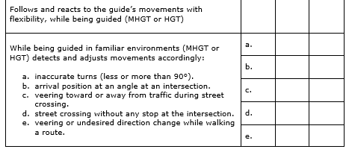
KINESTHETIC
SKILLS

Slide 18
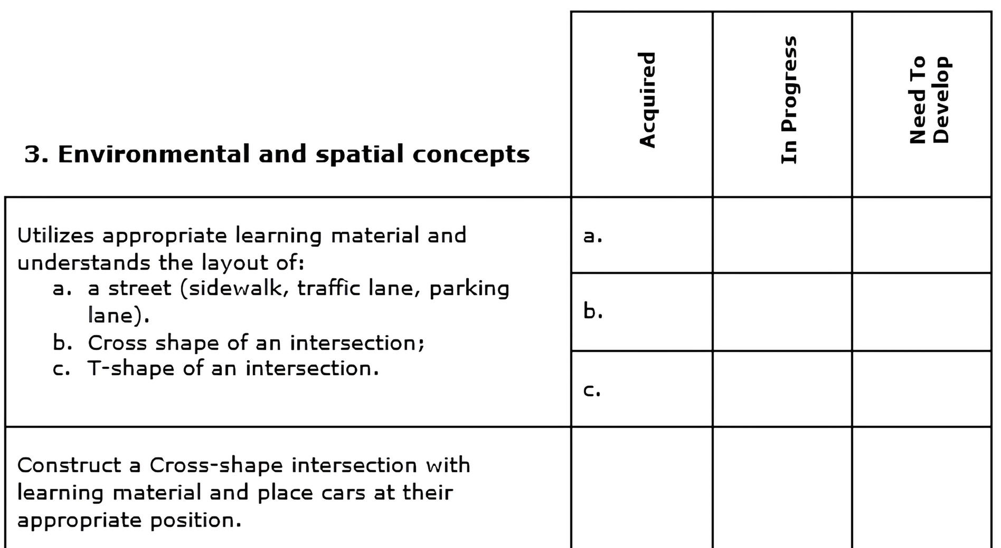
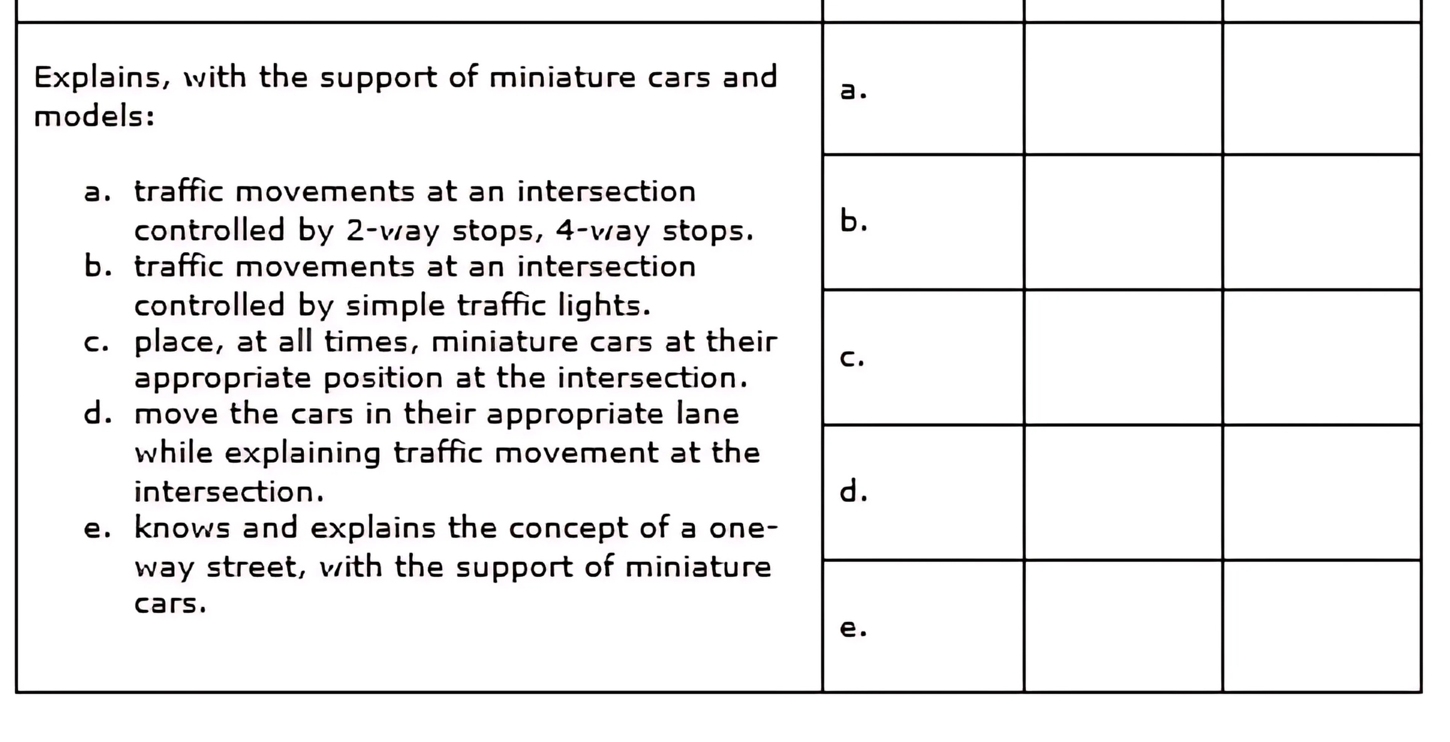
ENVIRONMENTAL & SPATIAL CONCEPTS

Slide 19
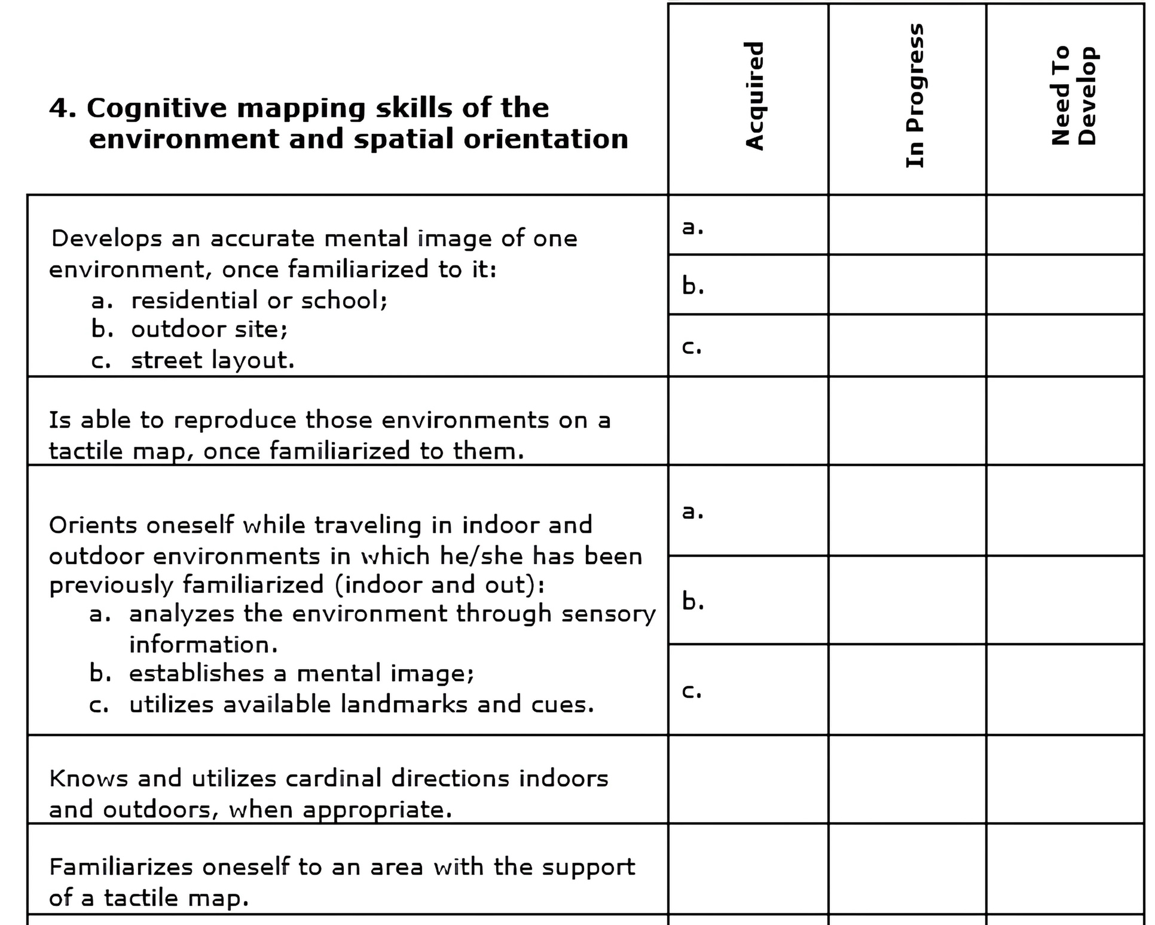
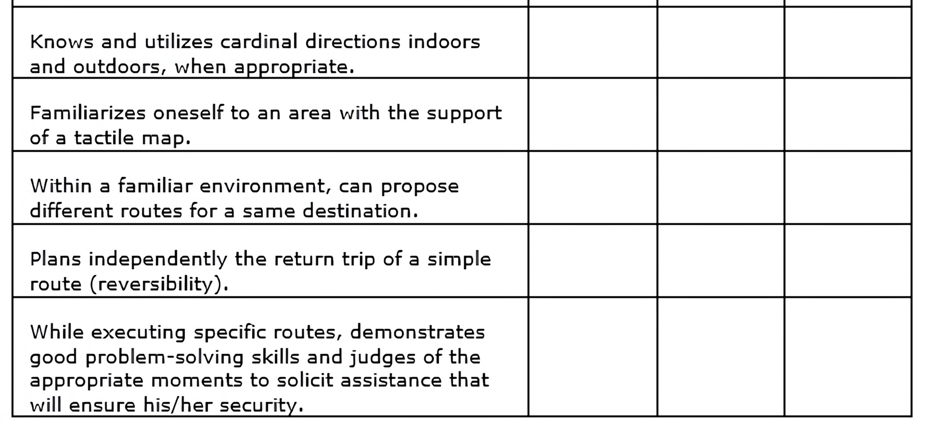
MAPPING
SKILLS

Slide 20
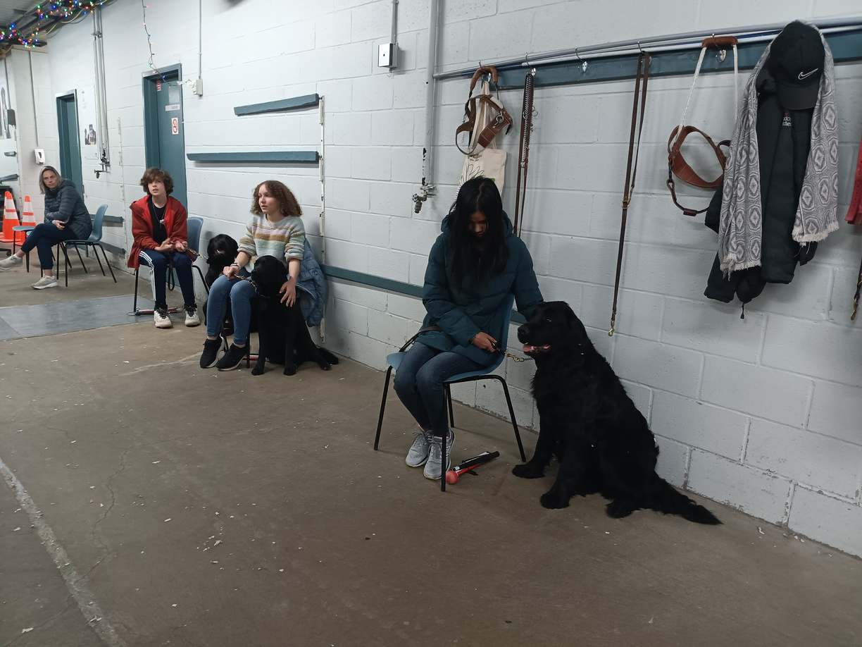
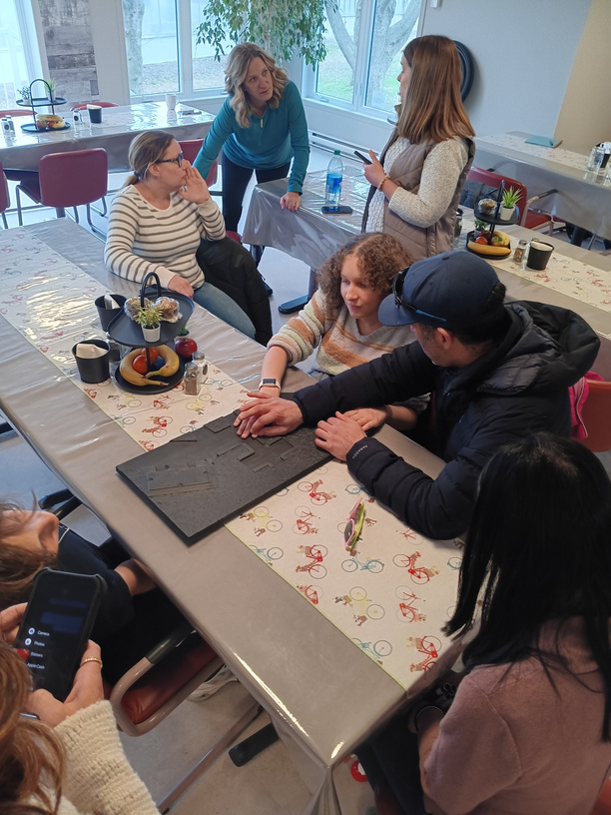
The Process – Guide Dog School
THE PROCESS
GUIDE DOG SCHOOL
A month of intensive training at Mira Canada normally in July.
At guide dog school, students learn essential skills to work safely and effectively with their guide dogs, including:
Guide Dog Handling: Commands for directing the dog, reinforcing positive behaviors, and managing distractions.
Bonding and Communication: Building a strong relationship with the guide dog through trust and clear communication.
Daily Care: Feeding, grooming, and maintaining the dog’s health and well-being.
Orientation & Mobility: Navigating different environments with the guide dog’s assistance safely

Slide 21

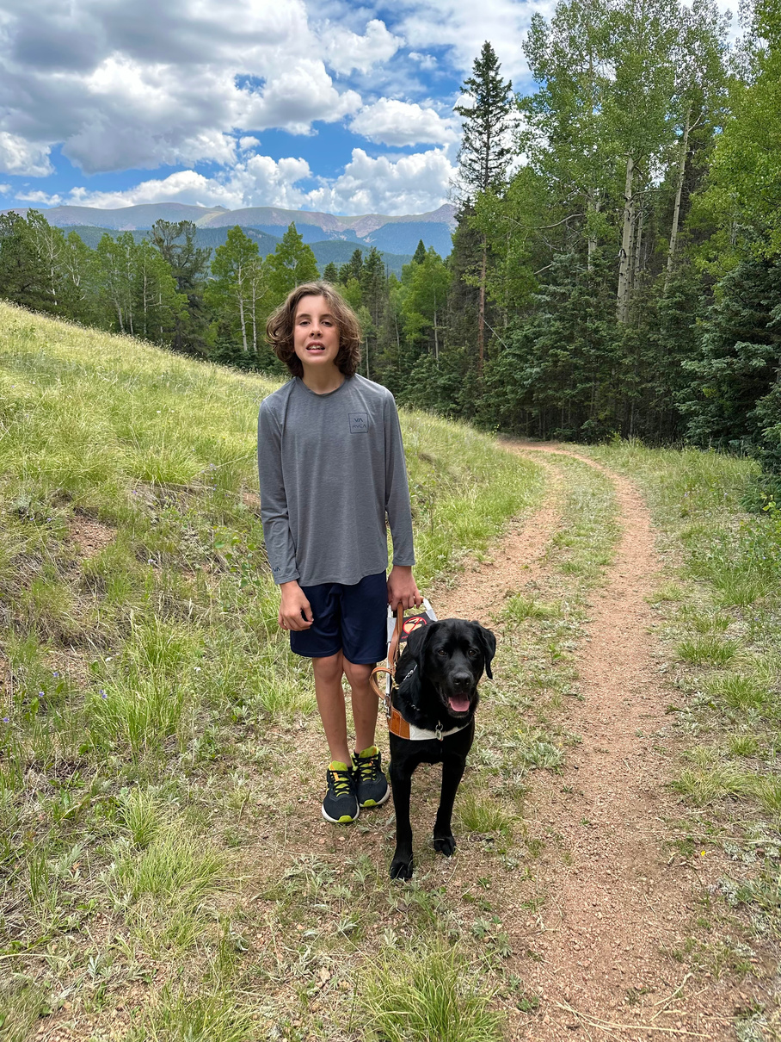
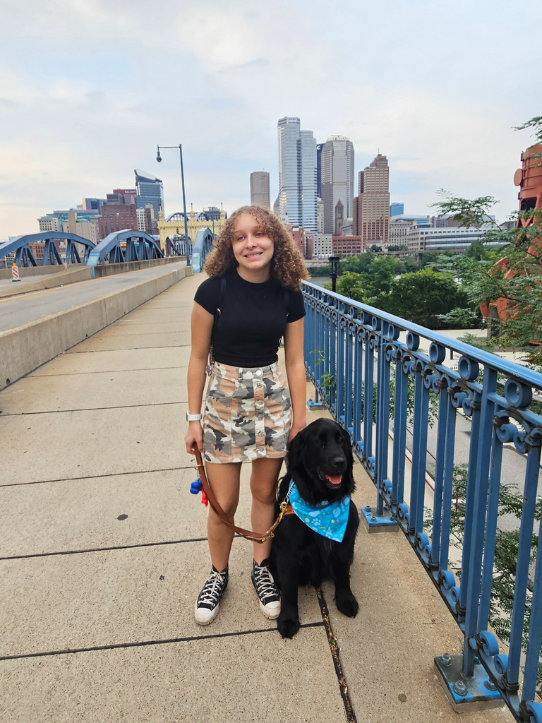


RECENT GRADUATES
ELIJAH, AGE 12
SHAELIN, AGE 14

Slide 22
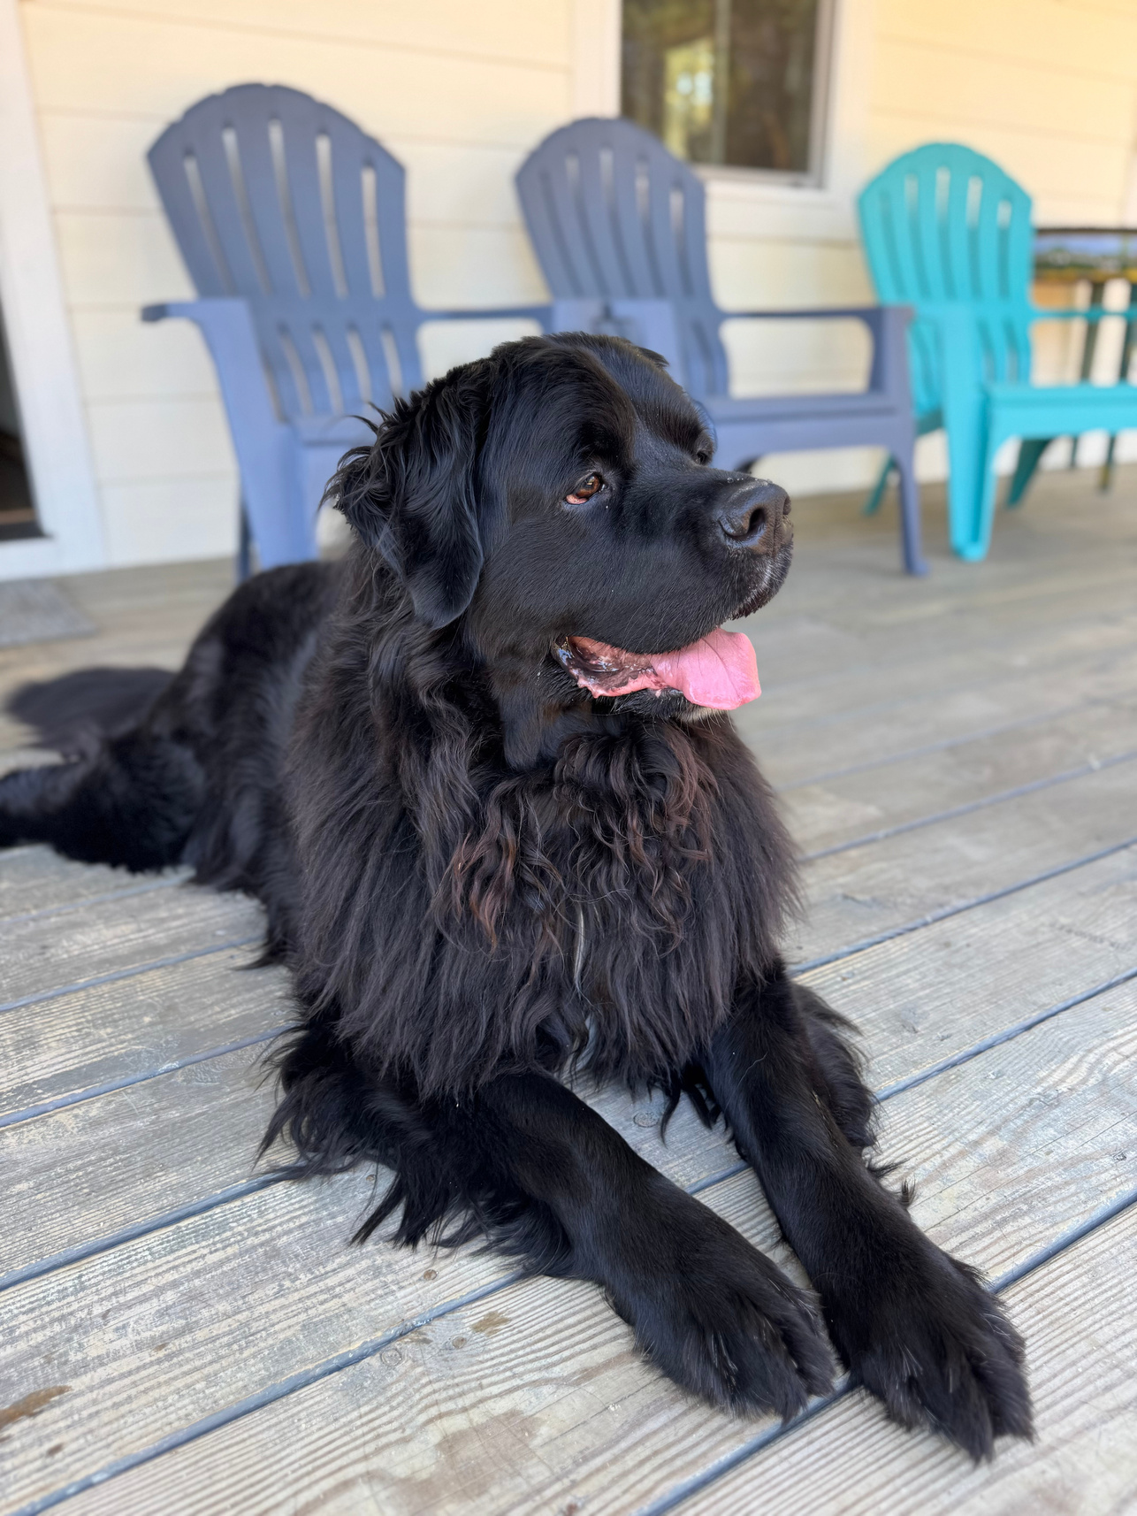
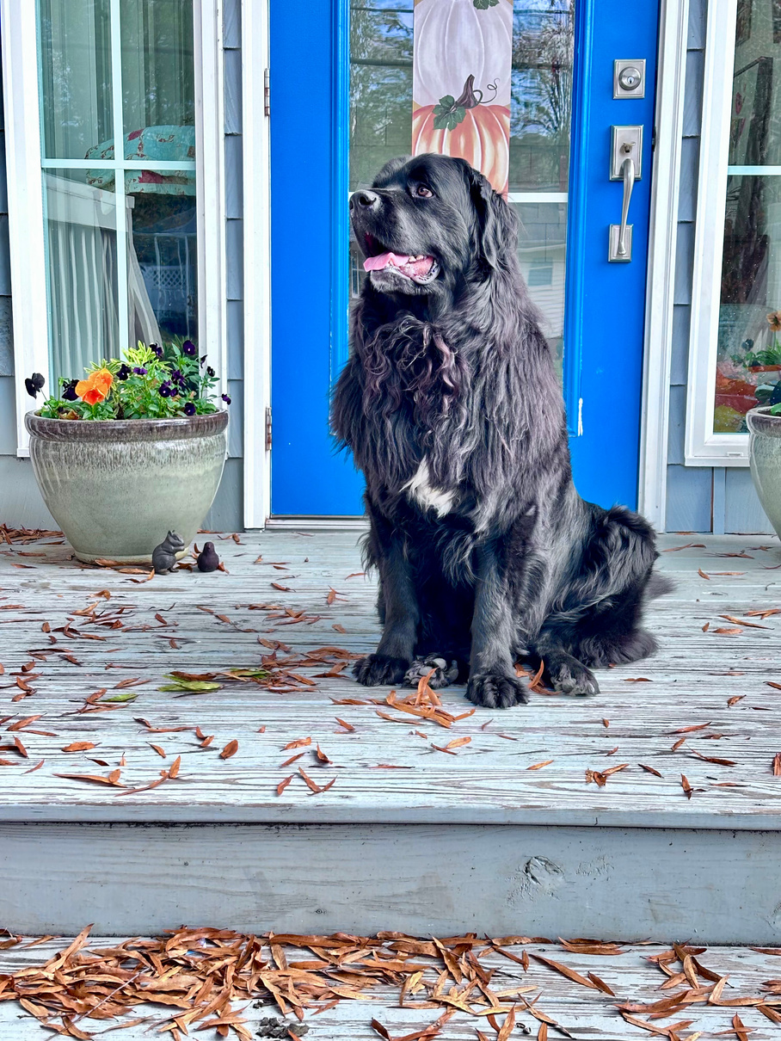
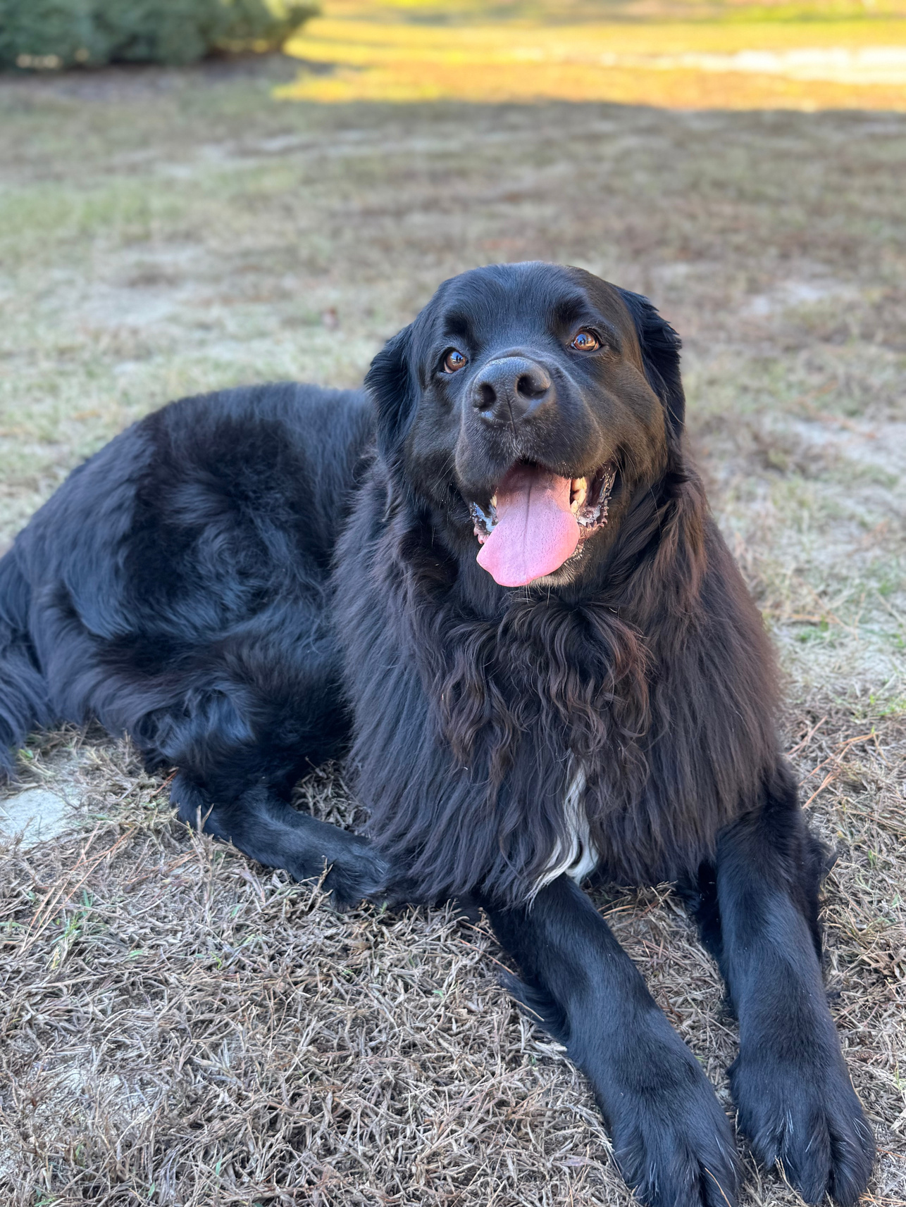
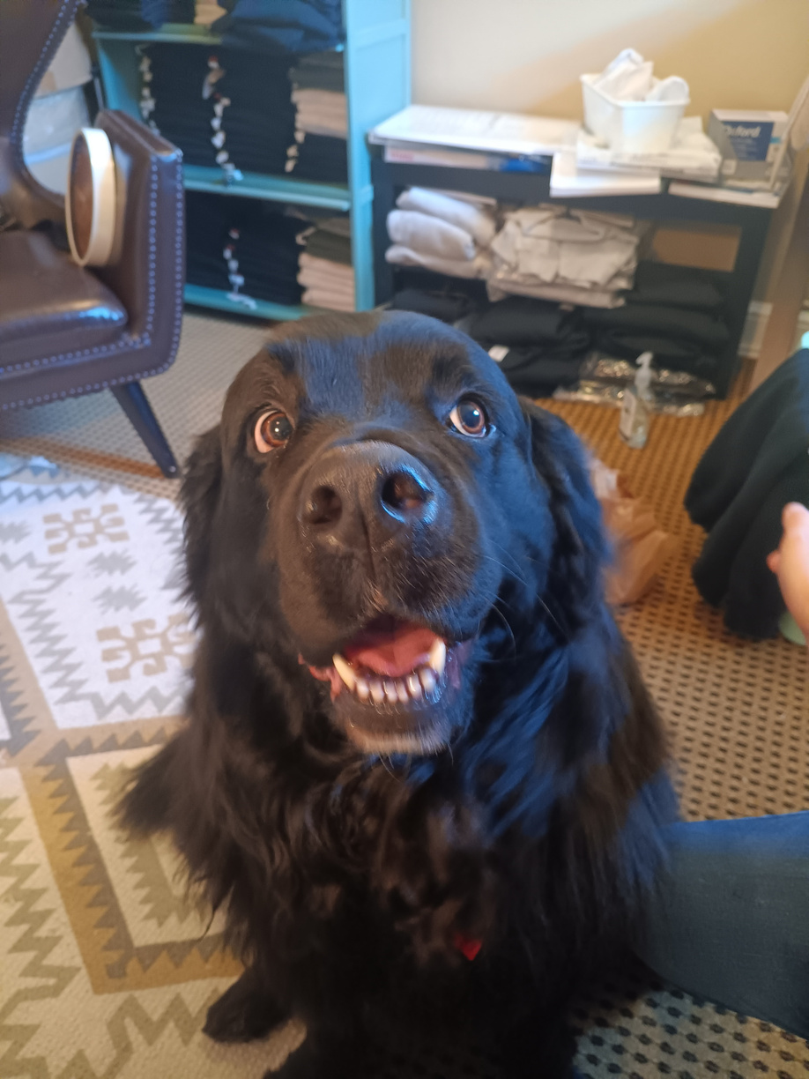

CHOPINE

Slide 23
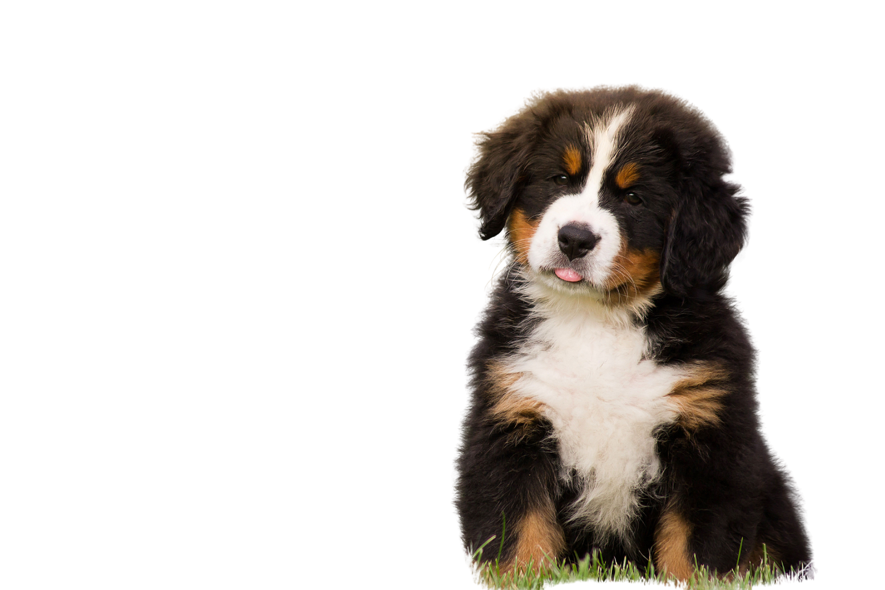
QUESTIONS

Slide 24



CONTACT US
info@mirausa.org
www.mirausa.org
510 NW Broad St.
Southern Pines, NC 28387

